Slide 1
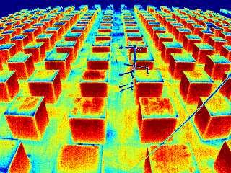
Physical and numerical modelling of
sub-facet surface temperature variability
Fred Meier ⁽¹⁾, Scott Krayenhoff ⁽²⁾, Atsushi Inagaki ⁽³⁾, Dieter Scherer ⁽¹⁾ , Andreas Christen ⁽²⁾, Manabu Kanda ⁽³⁾
⁽¹⁾ Department of Ecology, Technische Universität Berlin, Berlin, Germany
⁽²⁾ Department of Geography, University of British Columbia, Vancouver, BC, Canada
⁽³⁾ Department of International Development Engineering, Tokyo Institute of Technology, Tokyo, Japan
ICUC-8 Dublin
Fred Meier, August 10, 2012

Slide 2
Motivation
Progress has been made in micro-scale modelling of urban climates but validations of surface temperatures at the sub-facet scale have been limited by the lack of observations
Objective
to compare the variability of surface temperatures at the sub-facet scale by means of outdoor scale model observations and numerical simulations
ICUC-8 Dublin
Fred Meier, August 10, 2012
Notes:
How can we measure sub-facet surface temperature variability?
Is is possible to model these sub-facet temperature variability?

Slide 3
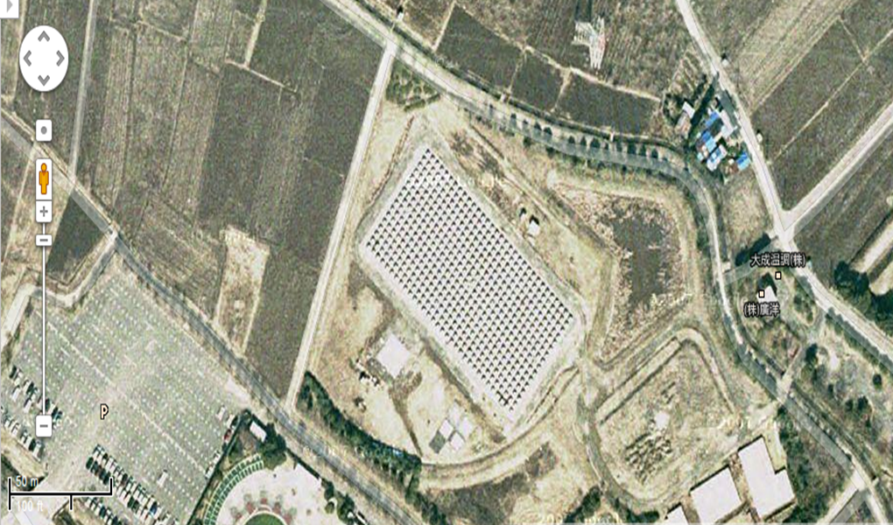
Comprehensive Outdoor Scale Model COSMO
Physical model
cubic concrete cubes
16 x 32 = 512
H = 1.5 m
λ_{p} = 0.25
Kanda M., Kanega M., Kawai T., Sugawara H. & Moriwaki R. (2007): Roughness lengths for momentum and heat derived from outdoor urban scale models. Journal of Applied Meteorology and Climatology, 46, 1067-1079.
ICUC-8 Dublin
Fred Meier, August 10, 2012
Notes:
Another approach is the use of an outdoor scale model (physical model). It eases experimental control, yet retains key aspects of the urban atmospheric variability. Additionally, it provides means to evaluate numerical models.

Slide 4
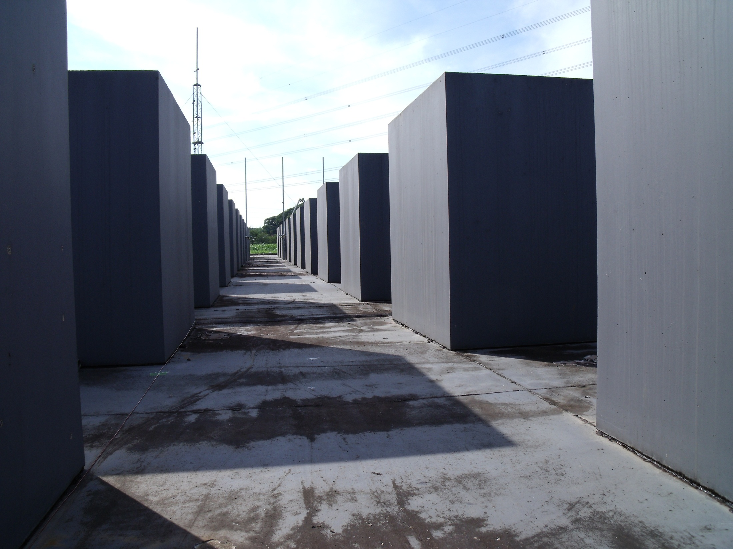

Slide 5
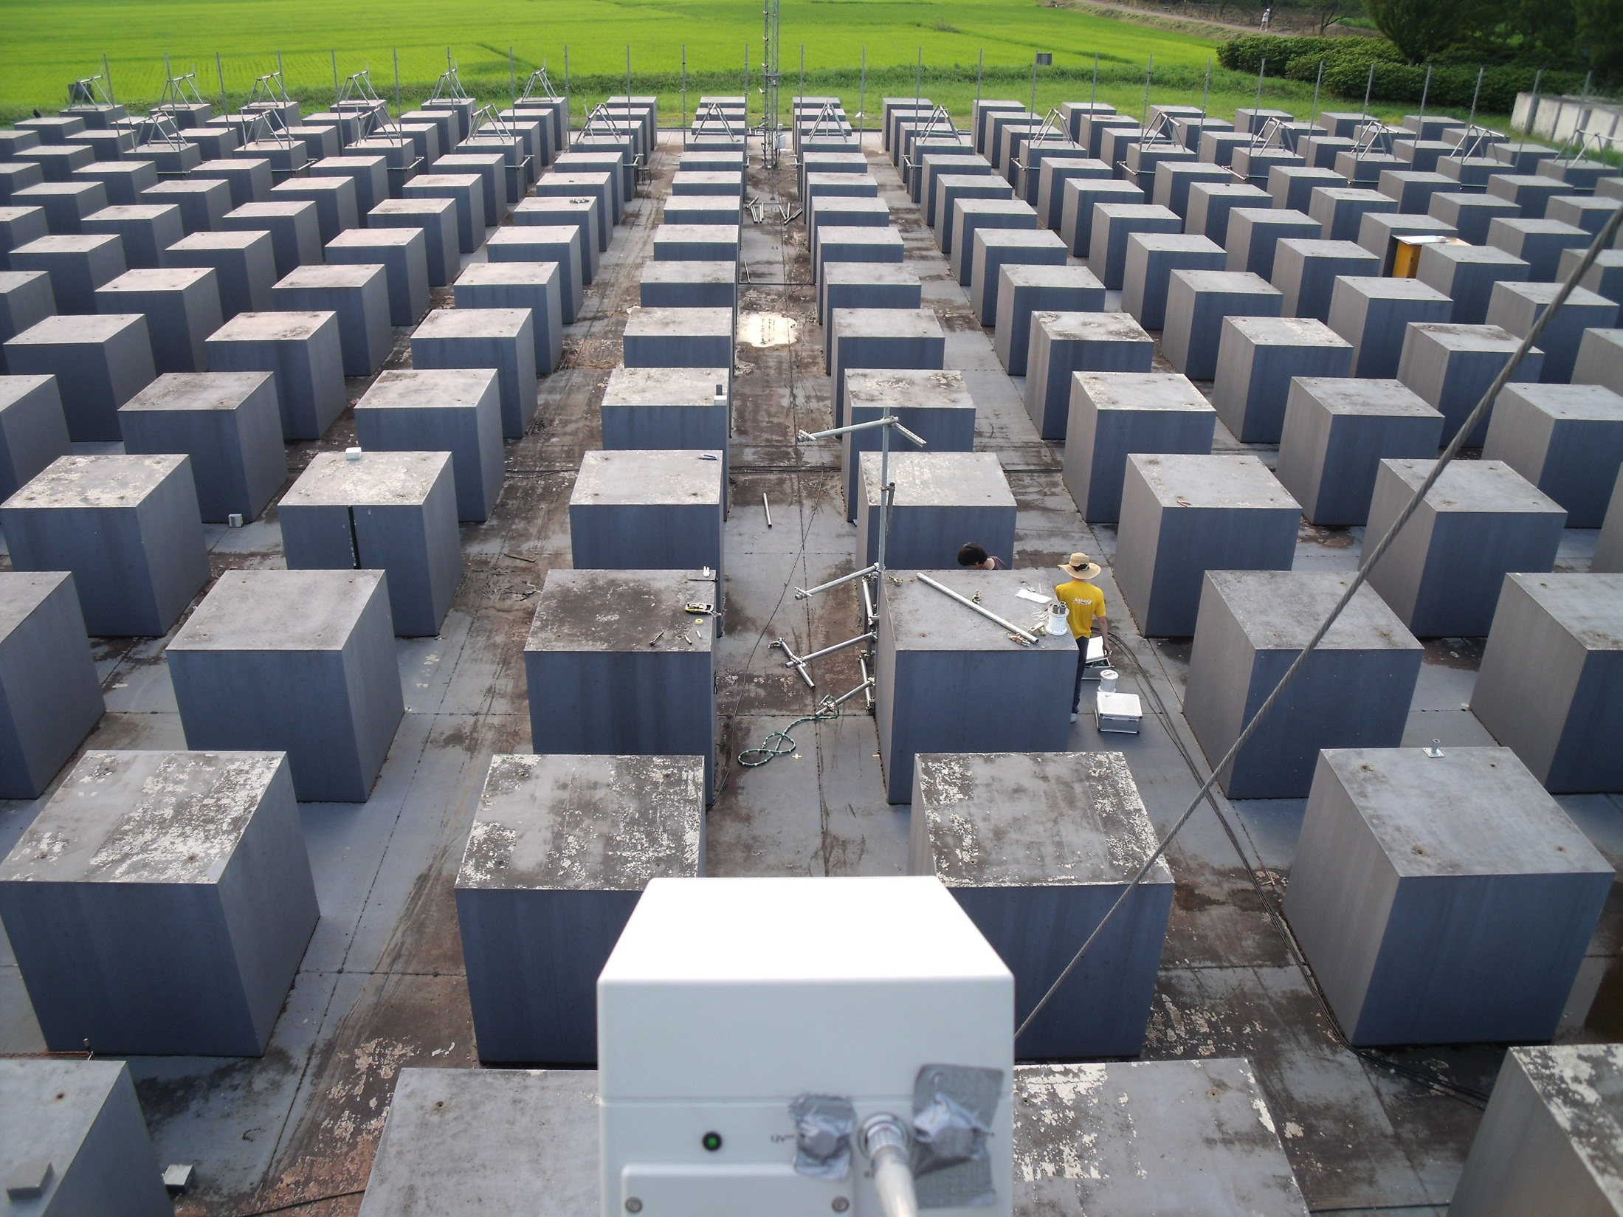
N
Street
Axis

Slide 6
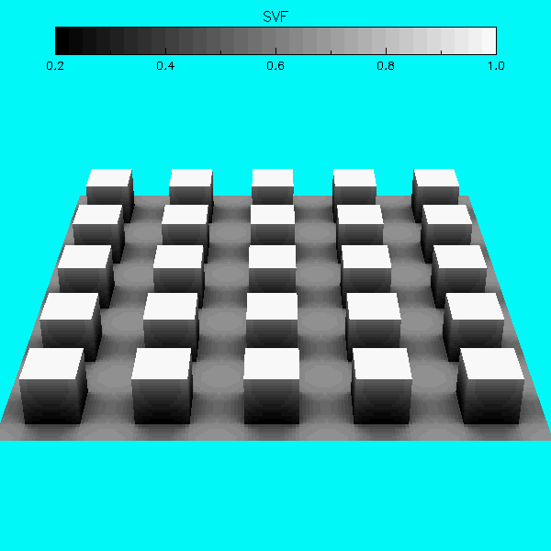
TUF-3D Temperature of Urban Facets in 3D
Krayenhoff E. S. & Voogt J. A. (2007): A microscale three-dimensional urban energy balance model for studying surface temperatures. Boundary-Layer Meteorology, 123, 433-461.
Notes:
Dry, no vegetation, 3d in terms of radiation
basic idea of the model is that solar radiation and radiation patterns are the main driver of Tb variability
1D in terms of conduction
1D windprofile and heat exchange coefficient
Energy balance of every patch of the roofs, walls and ground facets

Slide 7
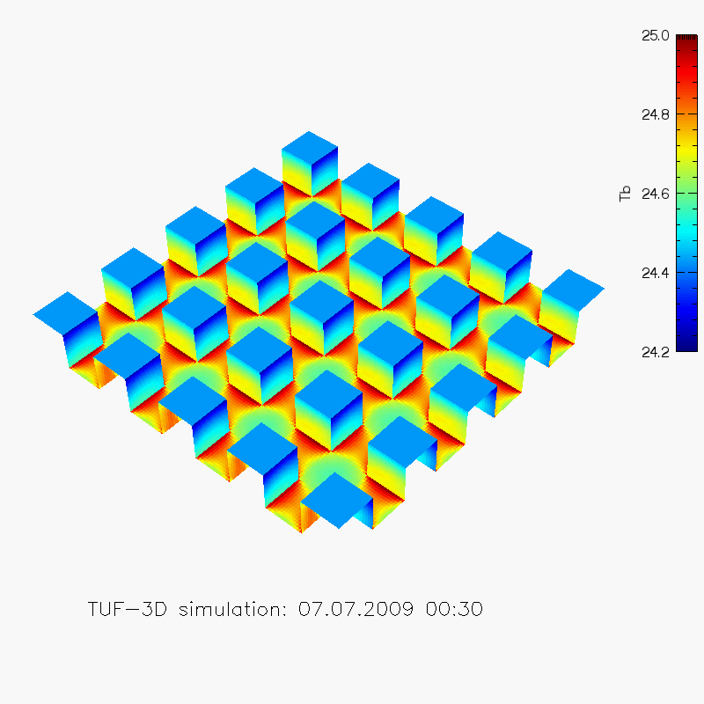
TUF-3D simulation
Variability of sub-facet surface temperature
Resolution: 10 cm
Spin up time: 24 h
ICUC-8 Dublin
Fred Meier, August 10, 2012
Notes:
With 24 h spin-up time

Slide 8
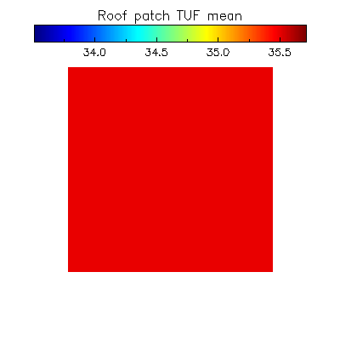
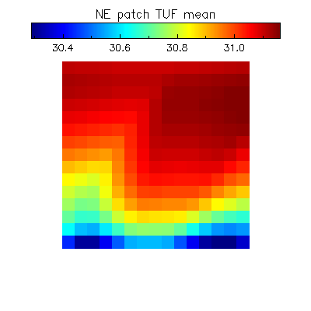
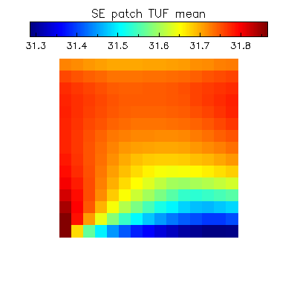
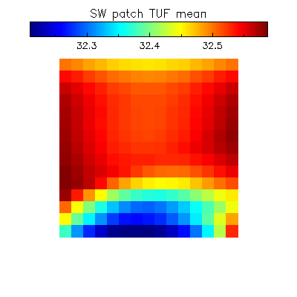
TUF-3D simulation
Variability of sub-facet surface temperature

Slide 9
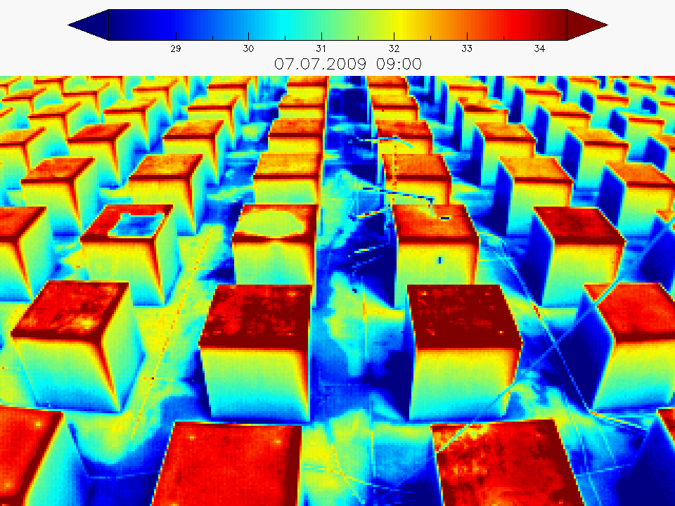

Slide 10
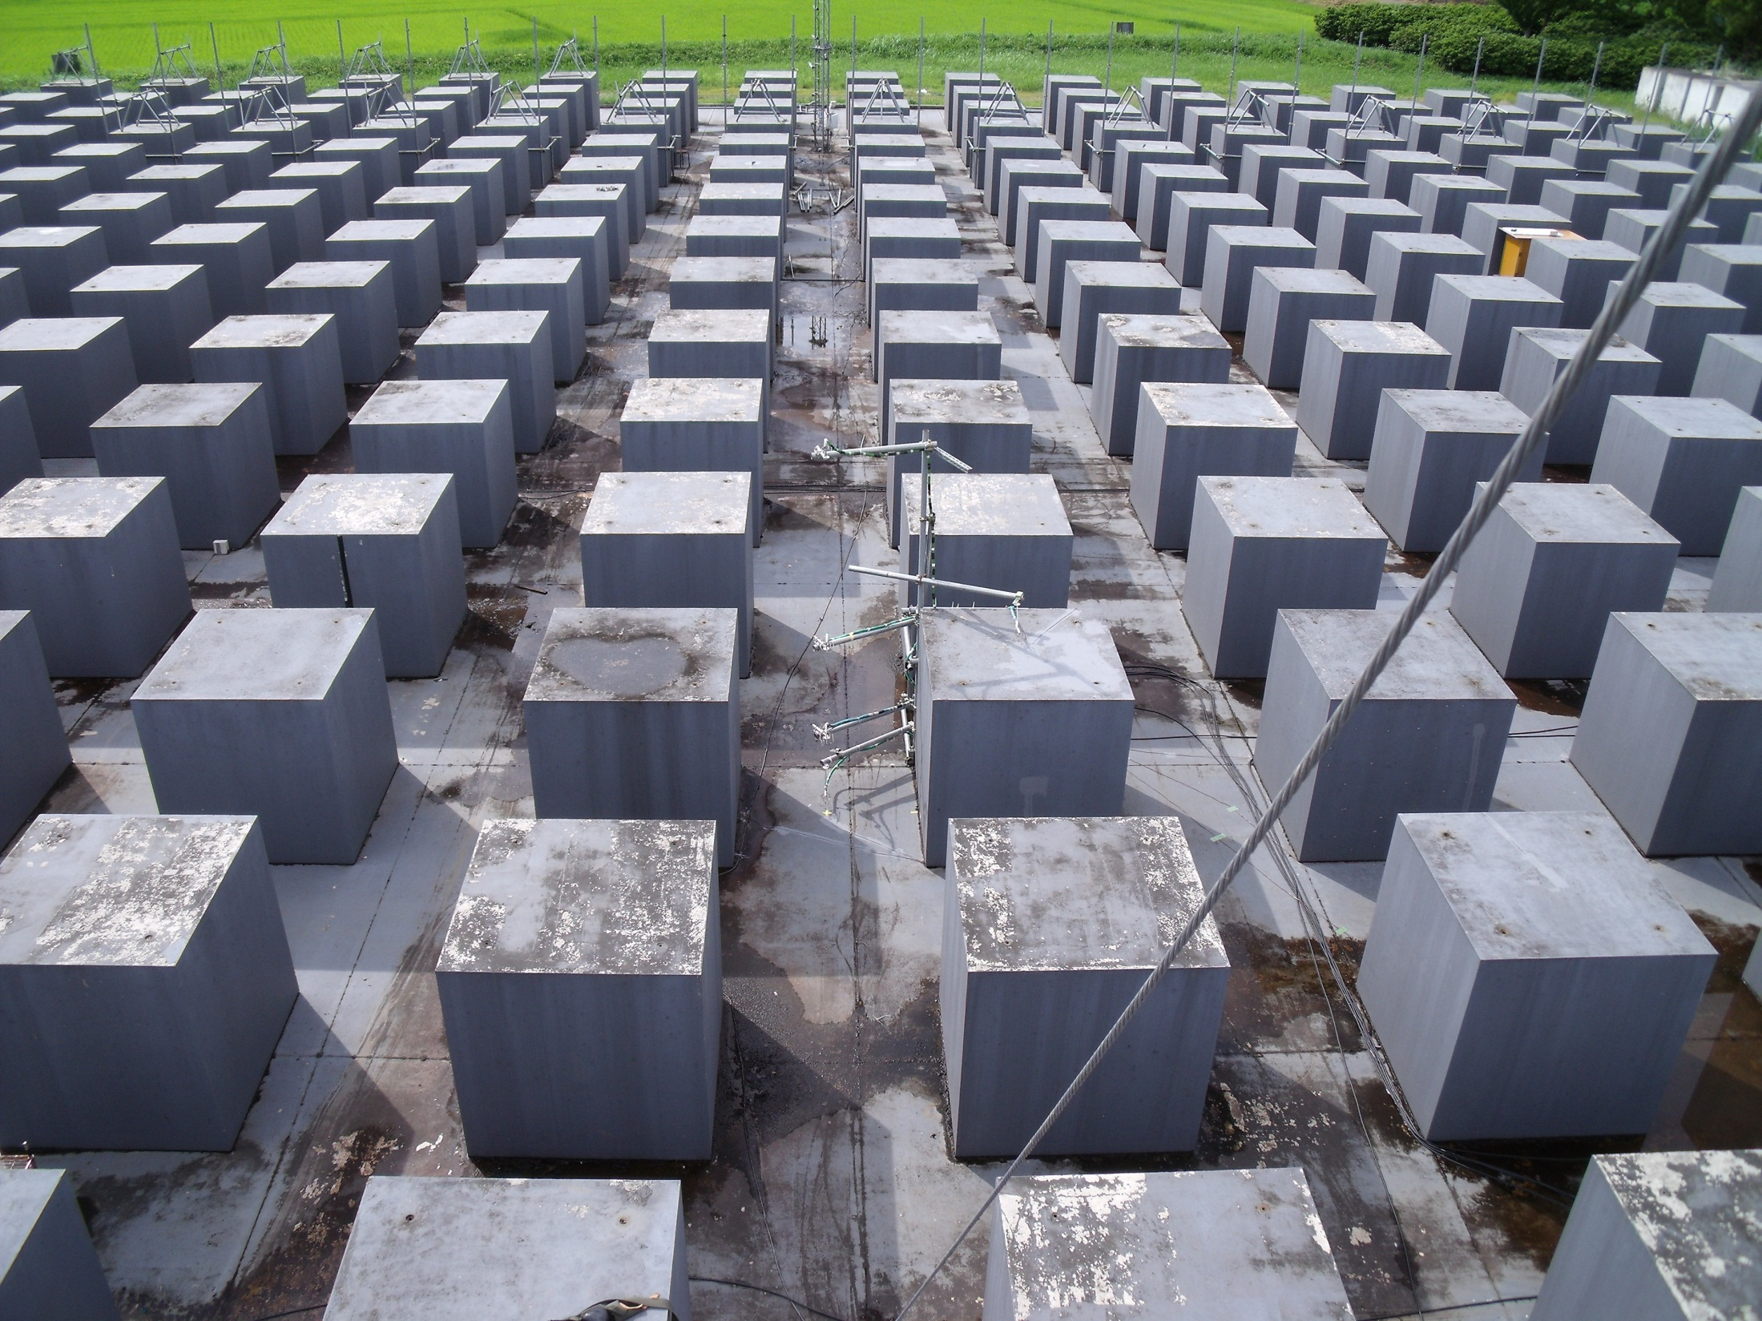
N
Street
Axis
Selected surfaces (roofs and NE-, SE- and SW-facing walls) for sub-facet analysis
Notes:
Selected surfaces for sub-facet analysis

Slide 11
TUF-3D simulation vs. COSMO measurements (roof)

Slide 12
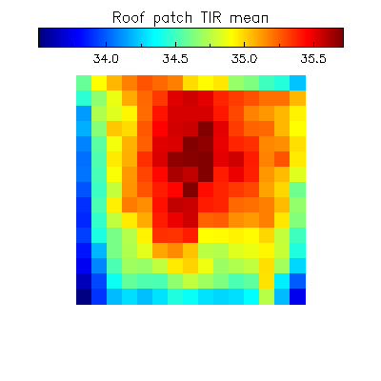
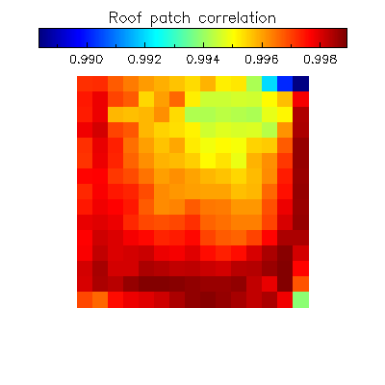
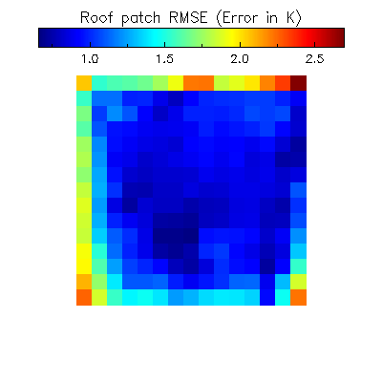
TUF-3D simulation vs. COSMO measurements (roof)

Slide 13
TUF-3D model output vs. COSMO measurements (NE-facing wall)

Slide 14
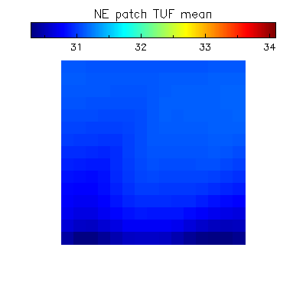
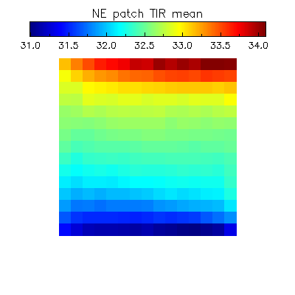
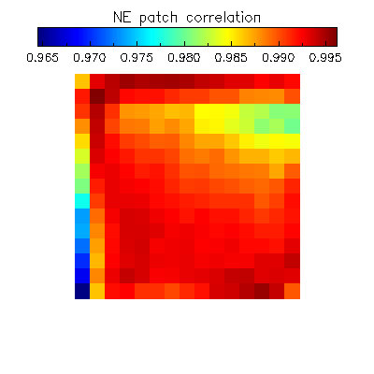
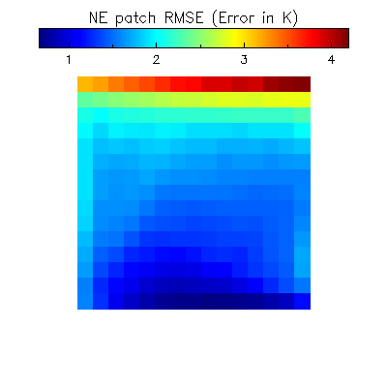
TUF-3D model output vs. COSMO measurements
NE-facing
wall

Slide 15
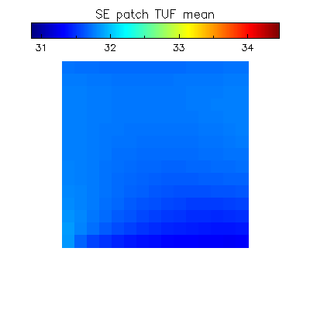
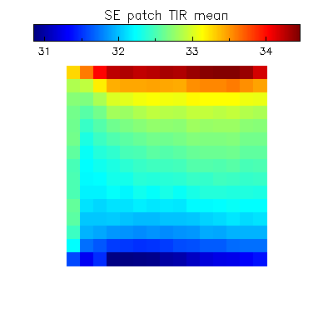
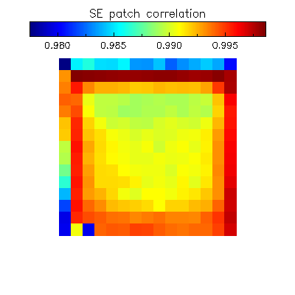
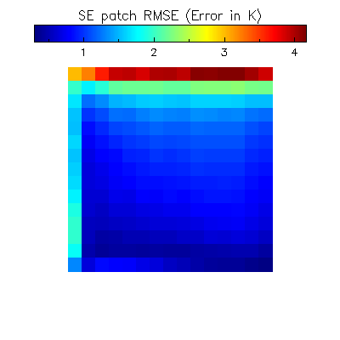
TUF-3D model output vs. COSMO measurements
SE-facing wall

Slide 16
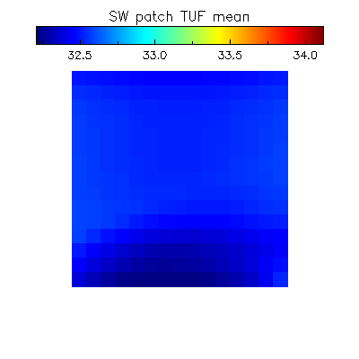
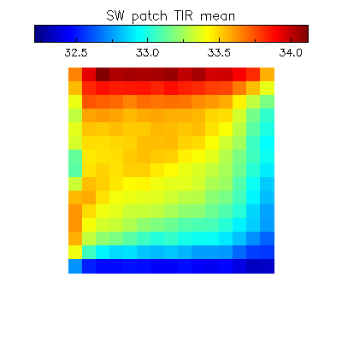
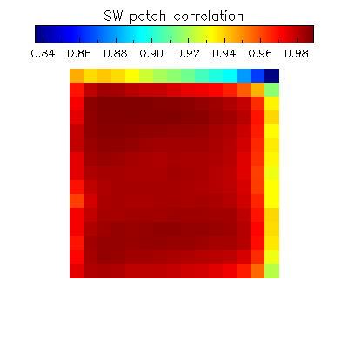
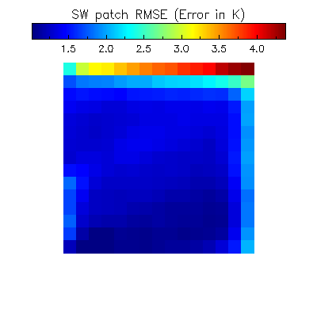
TUF-3D model output vs. COSMO measurements
SW-facing wall

Slide 17
Why is the observed temperature variability so high in comparison to the simulation?

Slide 18
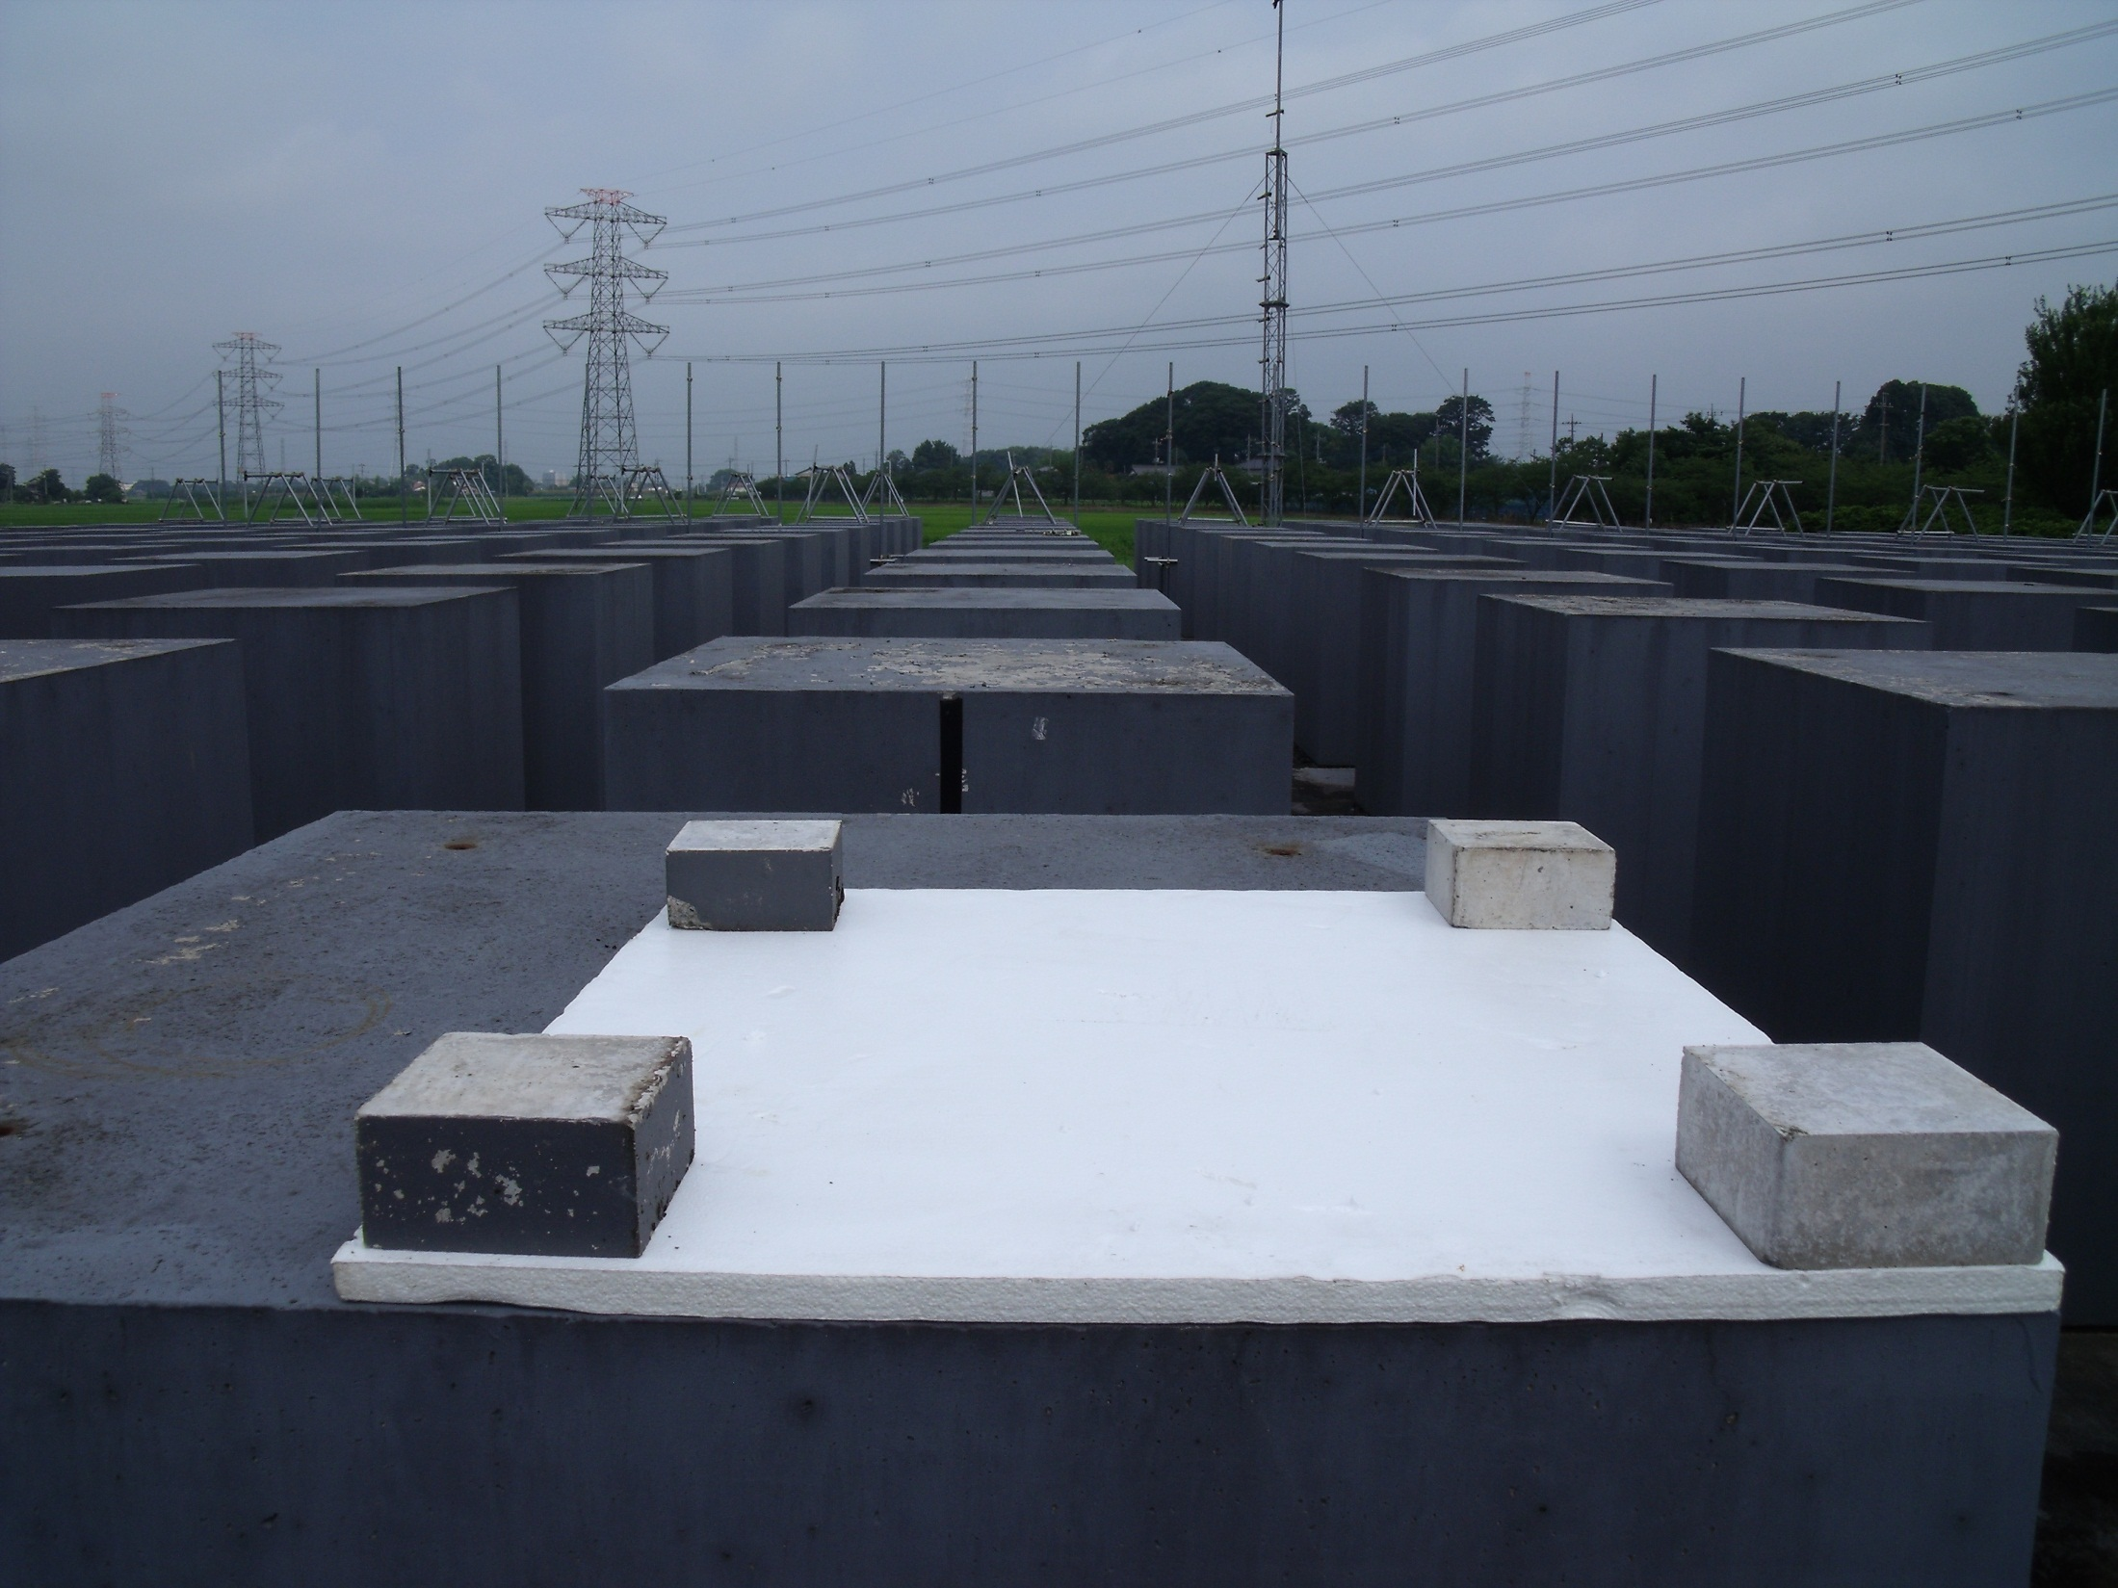
The role of conduction (2D) in terms of
surface temperature variability

Slide 19
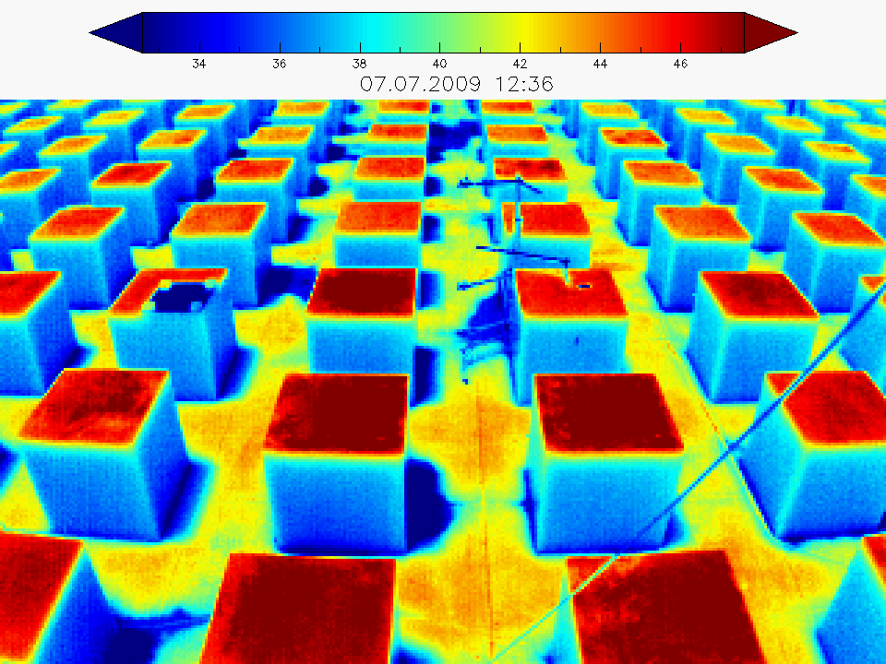

Slide 20
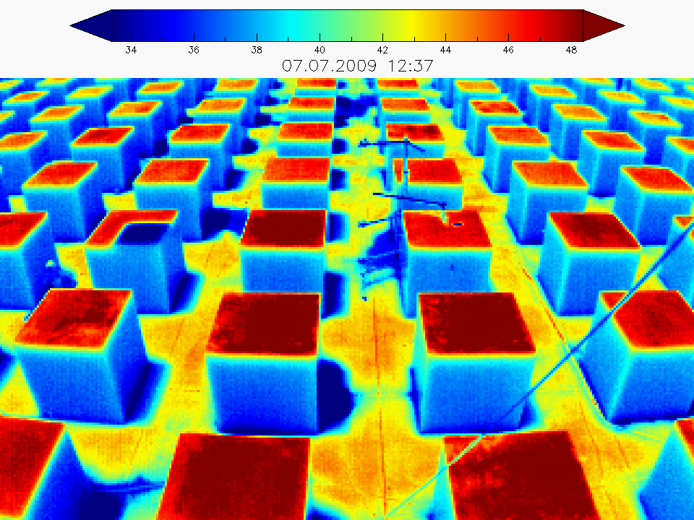

Slide 21
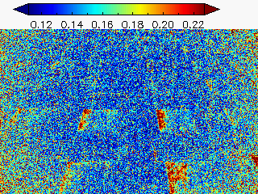
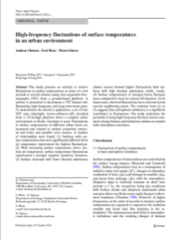
The role of convection in terms of
surface temperature variability
Higher fluctuations of surface temperatures close to edges
High-frequency Time-Sequential Thermography (1Hz)
Christen A., Meier F. & Scherer D. (2012): High-frequency fluctuations of surface temperatures in an urban environment. Theoretical and Applied Climatology, 108, 301-324.

Slide 22
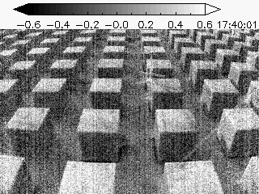

Slide 23
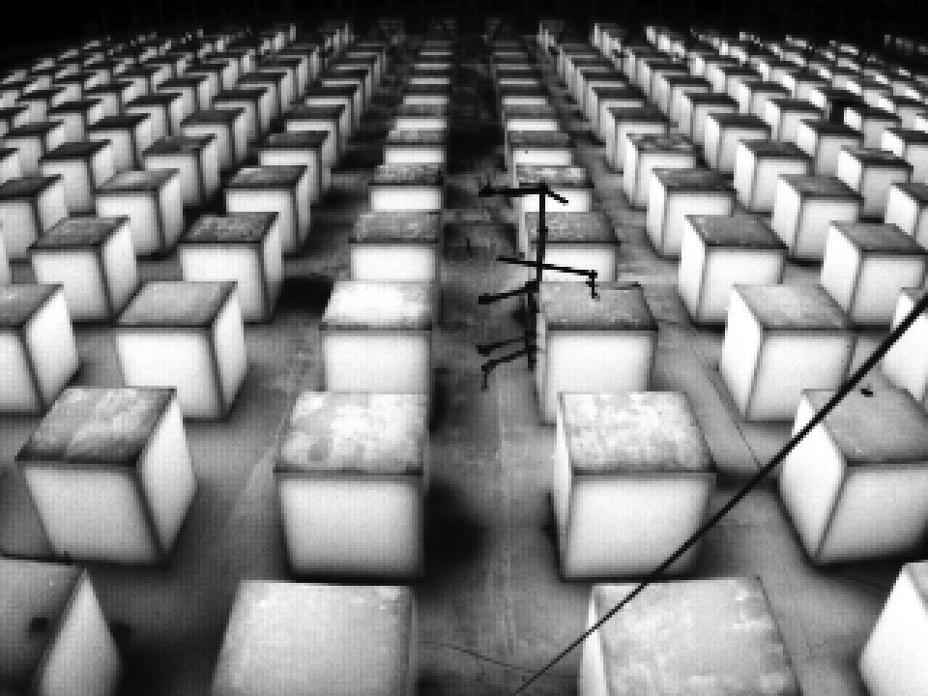
Conclusions (take home points)
Take care of your scale model and avoid changes in material properties!
Be aware of edge effects in scale models in terms of convection and conduction!
TUF-3D produces less sub-facet temperature variability but shows a good correlation with the measurements

Slide 24
Acknowledgements:
Aya Hagishima
Ken-ichi Narita
Jochen Richters
Hiroshi Takimoto

Slide 26
Experimental Setup

Slide 27
Meteorological forcing data
Radiation fluxes at COSMO site
ICUC-8 Dublin
Fred Meier, August 10, 2012

Slide 28
Meteorological forcing data
Air temperature (JMA Kuki Station)
ICUC-8 Dublin
Fred Meier, August 10, 2012

Slide 29
Meteorological forcing data
Windsped (JMA Kuki Station)
ICUC-8 Dublin
Fred Meier, August 10, 2012

Slide 30
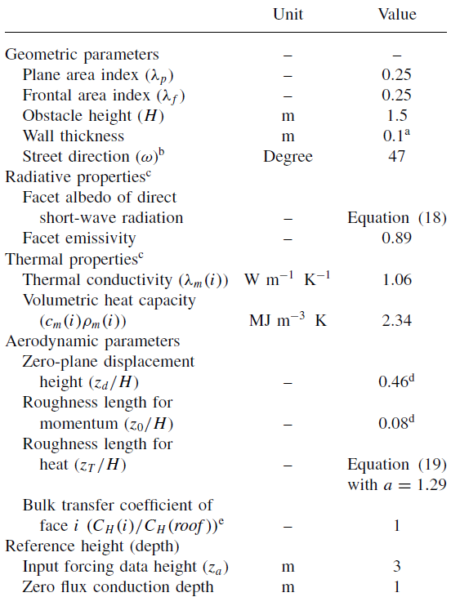
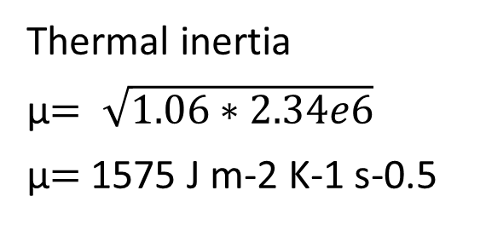
COSMO material properties
Thermal inertia
μ$= \sqrt{1.06∗2.34e6}$
μ$=$1575 J m-2 K-1 s-0.5
Kawai, T., Kanda, M., Narita, K., and Hagishima, A. (2007): Validation of a numerical model for urban energy-exchange using outdoor scale-model measurements. International Journal of Climatology, 27, 1931-1942.

Slide 31
